Slide 1


MULTIMODAL MOOD PREDICTION USING MEME IMAGES
PROJECT REPORT
Submitted by
SHANTHI S
(715523243052)
in partial fulfilment for the award of the degree of
BACHELOR OF TECHNOLOGY
IN
ARTIFICIAL INTELLIGENCE AND DATA SCIENCE
PSG INSTITUTE OF TECHNOLOGY AND APPLIED RESEARCH, COIMBATORE - 641 062
ANNA UNIVERSITY: CHENNAI - 600 025
JUNE 2025

Slide 2
ANNA UNIVERSITY: CHENNAI - 600 025
BONAFIDE CERTIFICATE
Certified that this project report “MULTIMODAL MOOD PREDICTION USING MEME IMAGES” is the bonafide work of “Shanthi S (715523243052)” who carried out the project work under my supervision.
----------------------------- SIGNATURE
Dr. S. Kalarani
------------------------------ SIGNATURE
Mrs. K. Sathya
HEAD OF THE DEPARTMENT
Professor and Head
Artificial Intelligence and Data Science PSG Institute of Technology and Applied Research,
Coimbatore – 641 062
SUPERVISOR
Assistant Professor
Artificial Intelligence and Data Science PSG Institute of Technology and Applied Research,
Coimbatore – 641 062
Submitted for the project viva-voce Examination held on
----------------------------------- INTERNAL EXAMINER
----------------------------------- EXTERNAL EXAMINER

Slide 3
ACKNOWLEDGMENT
“The real gift of gratitude is that the more grateful you're, the more present you become.” - Robert Holden
First and foremost, we express our deep sense of gratefulness to our respected Managing Trustee, Shri. L. GOPALAKRISHNAN for his provision to utilize all the necessary facilities in the institution.
We express our heartfelt gratitude to our beloved Principal of our institution, Dr. N SARAVANAKUMAR, for his overwhelming support and encouragement on this project.
We would also like to extend our heartfelt thanks to our honourable Secretary
Dr. P. V. MOHANRAM, for his moral support.
We are greatly indebted to the Head of the Department of Artificial Intelligence and Data Science, Dr. S. Kalarani, for her guidance and continuous support which was instrumental in the completion of this project.
We would like to extend our gratitude to all who helped us to complete this project. The project could not have been completed without the constant guidance and assistance of our supervisor Mrs. K. SATHYA, Assistant Professor, Department of Artificial Intelligence and Data Science, PSG Institute of Technology and Applied Research.
We are thankful to our project coordinator Mrs. K. SATHYA, Assistant Professor, Department of Artificial Intelligence and Data Science, PSG Institute of Technology and Applied Research.
Finally, we thank all the faculty of the Department of Computer Science and Engineering, PSG Institute of Technology and Applied Research, our friends and family members who helped us in getting the required instruments for our project and provided constant support and motivation to complete it successfully

Slide 4
ABSTRACT
This project proposes a multimodal deep learning framework for predicting meme mood categories—positive, negative, and neutral—using both textual and visual components. Traditional unimodal models fall short by ignoring the combined emotional cues in memes. Our approach utilizes both modalities to improve sentiment classification.
The architecture includes two branches:
The text branch processes meme captions using Bidirectional LSTM (BiLSTM) and 1D Convolutional (Conv1D) layers. BiLSTM captures
long-range text dependencies, while Conv1D detects local semantic patterns.
The image branch uses a custom CNN to extract spatial and visual features from the meme, such as facial expressions, objects, and overall composition.
The extracted features from both branches are concatenated in a fusion layer, then passed through dense layers and a softmax classifier to predict the final mood.
The model achieved a training accuracy of 73.83%, but a much lower testing accuracy of 28.88%, indicating overfitting. The gap suggests poor generalization due to factors like:
Limited dataset size
Model complexity
Suboptimal fusion methods
Future improvements include simplifying the model, adding regularization (e.g., dropout, L2), using data augmentation, and experimenting with better fusion strategies like attention mechanisms or transformer-based architectures to enhance generalization and performance.
Keywords: Multimodal Deep Learning, Sentiment Analysis, Meme Classification, BiLSTM, Conv1D, Convolutional Neural Network (CNN), Feature Fusion, Text and Image Fusion, Mood Prediction, Natural Language Processing (NLP), Computer Vision, Overfitting, Data Augmentation, Softmax Classification, Training vs Testing Accuracy, Early Stopping, Learning Rate Decay, Text Embedding, Image Preprocessing, Kaggle Meme Dataset

Slide 5
TABLE OF CONTENTS
CHAPTER | TITLE | PAGE
NO |  | NO 4
ABSTRACT
LIST OF FIGURES |  | 7
LIST OF ABBREVIATIONS |  | 8
1
INTRODUCTION
INTRODUCTION
PROBLEM STATEMENT
PROJECT REVIEW
BENEFITS OF EARLY DETECTION
SCOPE AND MOTIVATION
SCOPE
MOTIVATION
OBJECTIVES
ORGANIZATION OF THESIS
LITERATURE SURVEY
BACKGROUND STUDY
SYSTEM DESCRIPTION
OVERVIEW
DATASET DESCRIPTION
MODEL ARCHITECTURE
MODULES IMPLEMENTED
TOOLS AND LIBRARIES USED
9
2
14
3
15
4
SYSTEM DESIGN
OVERVIEW
SYSTEM ARCHITECTURE
16

Slide 6
SYSTEM IMPLEMENTATION
PROJECT OVERVIEW
5
OUTPUT AND RESULTS
22
6
CONCLUSIONS AND FUTURE WORK
26
CONCLUSION
FUTURE WORK
REFERENCES
28

Slide 7
LIST OF FIGURES
Figure Number | Description | Page number
4.1 | Meme Mood Prediction system Architecture | 17
5.1 | Output page - Negative Content | 23
5.2 | Output page - Positive Content | 24
5.3 5.4 5.5 5.6 | Output page - Neutral Content Classification Report for text model Classification Report for image model Classification Report for Multimodal model | 24 25 26 26

Slide 8
LIST OF ABBREVIATIONS
Abbreviation | Full Form
AI | Artificial Intelligence
NLP | Natural Language Processing
CNN | Convolutional Neural Network
BiLSTM | Bidirectional Long Short-Term Memory
Conv1D | 1D Convolutional Layer
DL | Deep Learning
ML | Machine Learning
ReLU | Rectified Linear Unit
Softmax | Soft Maximum (Activation Function)
LR | Learning Rate
Acc | Accuracy
Train Acc | Training Accuracy
Test Acc | Testing Accuracy
GPU | Graphics Processing Unit
TF | TensorFlow

Slide 9
INTRODUCTION
Introduction
In today's digital age, memes have emerged as a powerful and widely used medium for communication on social media platforms. They are not only humorous or satirical but also serve as a means of expressing emotions, opinions, and cultural commentary. A unique characteristic of memes is their multimodal nature—they combine text (captions, quotes, or dialogues) with images (facial expressions, visual metaphors, or symbolic art) to deliver a message or evoke a specific emotion.
Unlike traditional text or image-based content, memes rely on the synergistic effect of visual and textual cues to convey mood. For instance, the same image can project a different emotion depending on the overlaid text, and vice versa. This contextual dependency makes meme interpretation a complex task, especially for automated systems that attempt to classify or understand human sentiment.
1.2 Problem Statement
Conventional unimodal models, which focus exclusively on either the text or the image, often fall short in accurately determining the mood or sentiment conveyed by a meme. A model that only reads text may misinterpret sarcasm, while one that only analyzes the image may miss the emotional nuance added by the caption. As a result, there is a pressing need for multimodal models that can jointly analyze and reason over both types of content.
This project addresses this challenge by proposing a deep learning-based multimodal architecture for mood prediction in memes. The approach involves designing two parallel neural network branches—one for processing textual features using Bidirectional Long Short-Term Memory (BiLSTM) and 1D Convolutional layers (Conv1D), and another for processing visual features using a custom Convolutional Neural Network (CNN). The extracted features from both branches are then fused and passed through a classifier to predict the overall mood category of the meme: positive, negative, or neutral.

Slide 10
By integrating both modalities, the model aims to capture the full emotional context of the meme, thus outperforming unimodal baselines. However, challenges such as limited labeled datasets, overfitting, and optimal fusion strategies remain, motivating continued exploration and refinement.
Project Review
To address the challenges of mood prediction from memes, this project proposes a novel multimodal deep learning framework that jointly analyzes textual and visual content. The system processes meme text using a combination of Bidirectional Long Short-Term Memory (BiLSTM) and 1D Convolutional (Conv1D) layers to capture both sequential and local linguistic features. Simultaneously, meme images are resized, normalized, and fed into a custom Convolutional Neural Network (CNN) to extract visual features such as facial expressions, objects, and background context.
The features from the text and image branches are then concatenated and passed through dense classification layers to predict the mood category—positive, negative, or neutral. This fusion approach enables the model to leverage complementary cues from both modalities, which is critical given the intertwined nature of meme semantics.
Key advantages of this approach include:
Multimodal Understanding: Integrates textual and visual information for richer mood interpretation beyond unimodal limitations.
Deep Feature Extraction: Uses advanced neural architectures tailored for sequential text data and spatial image data.
Scalability: Designed to work with a publicly available meme dataset, supporting potential future extensions with larger and more diverse data.
Practical Relevance: Applicable to content moderation, user engagement analysis, and digital media psychology.
Despite achieving a training accuracy of approximately 73.83%, the model faces challenges of overfitting, as indicated by a lower test accuracy (~28.88%). This highlights areas for improvement such as regularization, data augmentation, and enhanced fusion strategies.

Slide 11
Overall, this project provides a foundational multimodal approach for automated mood classification of memes and opens pathways for future research incorporating attention mechanisms, pretrained embeddings, and transformer-based fusion models.
1.4 Benefits of the Project
Improved Mood Detection Accuracy: By combining both text and image data, the model captures richer emotional context, leading to more accurate mood classification compared to unimodal approaches.
Enhanced Understanding of Multimodal Content: Memes rely heavily on the interplay between visuals and text; this project helps in interpreting such complex multimodal cues effectively.
Applications in Content Moderation: Automated mood prediction can assist social media platforms in filtering or flagging content based on emotional tone, helping maintain a safer online environment.
User Engagement Analysis: Brands and marketers can leverage mood insights from memes to better understand audience sentiment and tailor their campaigns accordingly.
Support for Psychological and Social Research: The model offers tools to analyze emotional trends and social commentary expressed through memes, aiding studies in digital media psychology.
Scalable and Cost-effective: The system processes widely available meme data without requiring expensive equipment or invasive procedures, making it accessible for large-scale deployment.
Foundation for Future Innovations: This project lays the groundwork for advanced multimodal sentiment analysis, opening paths to integrate newer models and fusion techniques.

Slide 12
Scope and Motivation
Scope
The scope of this project encompasses the development of a multimodal neural network that integrates text and image processing for mood classification of memes into positive, negative, or neutral categories. The project focuses on:
Preprocessing and feature extraction from meme text using BiLSTM and Conv1D layers.
Visual feature extraction from meme images via a custom Convolutional Neural Network.
Fusion of extracted features followed by classification using dense neural network layers.
Evaluation of model performance on a labeled dataset of memes with mood annotations
The system is designed to be scalable and adaptable for deployment in applications such as social media content moderation, marketing analytics, and psychological studies. While current work is limited to static memes, the framework sets the foundation for future enhancements, including attention-based fusion techniques, transformer models, and multimodal emotion recognition in videos or GIFs.
Motivation
Memes have become one of the most popular forms of communication on social media, often expressing complex emotions, opinions, and cultural commentary through the combination of text and images. However, understanding the mood conveyed by memes poses a unique challenge due to their inherently multimodal nature. Traditional sentiment analysis methods that focus solely on text or images tend to misinterpret the intended emotion, especially when sarcasm or subtle visual cues are involved.
This project is motivated by the need to build a robust system that can jointly analyze both textual and visual elements to accurately predict the mood of a meme. By leveraging advanced deep learning techniques, the model aims to overcome the limitations of unimodal approaches and provide better insight into online emotional expression. This has important implications for content moderation, user engagement analysis, and digital media research.

Slide 13
Objectives
To preprocess and clean both textual and visual data from memes for effective feature extraction.
To design a dual-branch neural network architecture that extracts meaningful features from meme text using BiLSTM and Conv1D layers.
To develop a custom Convolutional Neural Network (CNN) to extract visual features from meme images.
To fuse the textual and visual features to create a comprehensive multimodal representation.
To classify memes into mood categories: Positive, Negative, or Neutral based on the fused features.
To evaluate the model’s performance using appropriate metrics and analyze challenges such as overfitting.
To propose future enhancements for improving generalization, such as advanced fusion methods, regularization, and transfer learning.
Organization of Thesis
This thesis is structured to provide a comprehensive understanding of the multimodal mood prediction system, from background context to model development and evaluation:
Chapter 1: Introduction
Introduces the problem of mood prediction in multimodal content, outlines the motivation and scope, and presents a high-level overview of the proposed deep learning approach using meme images.
Chapter 2: Dataset Description
Describes the ‘6992 Labeled Meme Images’ dataset used in the project, including its structure, data labels, and relevance to the problem domain.

Slide 14
Chapter 3: Model Architecture
Details the architecture of the proposed system, including the design of the text processing branch (BiLSTM + Conv1D), the image processing branch (custom CNN), and the fusion strategy used for mood classification.
Chapter 4: Training and Results
Covers the training setup, parameters, evaluation metrics, and the results obtained from both training and testing phases. Discusses the performance gap and challenges encountered such as overfitting.
Chapter 5: Conclusion and Future Work
Summarizes the overall contributions of the project, evaluates the system's limitations, and outlines potential directions for improving accuracy, scalability, and applicability of the model in real-world scenarios
LITERATURE SURVEY
Background Study
With the rise of social media, memes have become a powerful form of communication that blends text and images to express emotions and opinions. This multimodal nature makes mood prediction challenging, as traditional unimodal sentiment analysis models often fail to capture the full context.
Earlier research focused on analyzing either text or image separately. Text-based models using LSTM or traditional classifiers often misinterpret humor or sarcasm without visual cues. Similarly, image-based models like CNNs may miss the emotional intent behind meme captions.
Recent studies have explored multimodal approaches. Sharma et al. (2022) used BiLSTM for text and ResNet-50 for image features, combining them through late fusion and achieving ~68% accuracy. Ghosal et al. (2023) applied transformer-based models for improved performance, but their approach required large datasets and heavy computation.
These works highlight the importance and complexity of combining text and image understanding for sentiment analysis. However, issues like overfitting, feature misalignment, and generalization remain unresolved—motivating the need for efficient, scalable, and interpretable multimodal solutions like the one proposed in this project.

Slide 15
SYSTEM DESCRIPTION
Overview
The proposed system is developed to predict the mood conveyed by meme images by leveraging both visual and textual information. Using a multimodal deep learning architecture, the system processes captions through a BiLSTM + Conv1D network and images through a custom CNN. Extracted features from both branches are fused to capture the combined emotional context. This integrated approach allows the model to better interpret humor, sarcasm, and sentiment often missed by unimodal methods, improving overall prediction accuracy and contextual understanding.
Dataset Description
The dataset used in this project consists of 6,992 labeled meme images sourced from Kaggle. Each meme includes a static image paired with a corresponding textual caption and is annotated with a mood label: Positive, Negative, or Neutral. All images are preprocessed for resizing and normalization, while the text is tokenized and padded for input consistency. The dataset captures diverse linguistic styles and visual contexts, simulating real-world social media content. Feature representations from both modalities are combined, creating a comprehensive multimodal dataset suitable for training the deep learning model.
Model Architecture
The mood prediction pipeline integrates multiple components:
Text Branch: Captions are tokenized, embedded, and passed through a BiLSTM layer followed by a 1D Convolutional layer to capture both sequential patterns and local semantic features.
Image Branch: Meme images are resized and normalized, then passed through a custom CNN that extracts visual cues such as facial expressions, objects, and scene context.
Fusion & Classification:
Features from both branches are concatenated into a unified representation.
Fully connected dense layers are applied to perform mood classification into Positive, Negative, or Neutral categories.
The dual-branch architecture ensures that both textual tone and visual emotion are considered for robust prediction.

Slide 16
3.4 Modules Implemented
Text Preprocessing Module: Cleans, tokenizes, and pads meme captions to prepare them for embedding and sequence modeling.
Image Preprocessing Module: Resizes and normalizes meme images to a fixed input size suitable for CNN processing.
Feature Extraction Module: Extracts semantic features from text using BiLSTM + Conv1D and visual features using a custom CNN.
Prediction Engine: Concatenates features, feeds them into a classification layer, and outputs the predicted mood category with confidence.
3.5 Tools and Libraries Used
TensorFlow & Keras for building and training deep learning models.
OpenCV & PIL for image preprocessing and manipulation.
NumPy & Pandas for data handling and numerical operations.
NLTK & TensorFlow Text for text tokenization and sequence processing.
Matplotlib & Seaborn for visualizing training metrics and results.
SYSTEM DESIGN
Overview
The system is designed to analyze meme content and predict its mood category using a multimodal deep learning approach. It combines separate branches for processing image and text data, ensuring that both visual and linguistic cues contribute to the final prediction. The architecture is modular and optimized for ease of experimentation, fusion flexibility, and improved sentiment understanding in digital media..

Slide 17
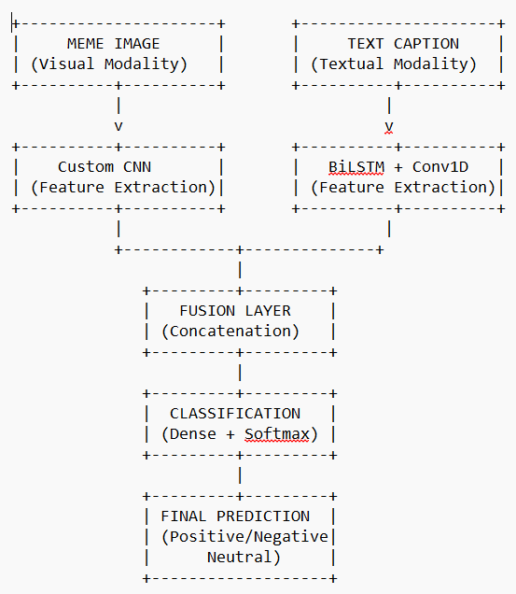
4.2 System Architecture
The system architecture consists of a dual-branch neural network pipeline: one dedicated to textual analysis using BiLSTM and Conv1D layers, and another for image analysis via a custom CNN. Features from both streams are concatenated and passed through dense layers for final classification. This modular setup allows for targeted improvements in preprocessing, feature extraction, and fusion strategies.
Figure 4.1 Model Architecture
4.2.1 Input Image and Text Data
The system starts by acquiring meme images from the user or dataset, which serve as the primary data source for mood prediction. Each meme contains two key components: the image itself and the embedded textual caption. The image provides visual cues such as facial expressions, colors, and objects, while the text often conveys humor, sarcasm, or sentiment, both critical for accurate mood classification.
Users or datasets provide meme images in standard formats such as .jpg, .png, or
.jpeg. It is essential that the images are clear, with legible text captions and minimal noise, distortion, or occlusion. Blurred or low-resolution images, or those with unreadable text, can reduce the accuracy of feature extraction in both the visual and textual branches of the model.

Slide 18
For the text data, captions are extracted either via accompanying metadata or through Optical Character Recognition (OCR) when embedded in the image. The extracted text must be sufficiently clean and well-segmented to allow effective tokenization and subsequent feature processing by the BiLSTM and Conv1D layers.
This input acquisition stage forms the basis for all downstream tasks. The quality and clarity of both image and text inputs directly affect preprocessing success and the overall performance of the multimodal mood prediction model.
.
4.2.2 Preprocessing
The preprocessing stage prepares both the meme images and their textual captions to ensure effective feature extraction and robust model training.
For the image data:
Each input meme image is first resized to a fixed resolution of 224×224 pixels to maintain consistency across samples and reduce computational complexity. The images are then normalized by scaling pixel values to the [0,1] range, which helps stabilize training. To reduce noise and improve feature clarity, image augmentation techniques such as random rotations, flips, and brightness adjustments can be optionally applied during training. This ensures the model generalizes better to diverse meme styles and qualities.
For the text data:
The textual captions associated with each meme are cleaned by removing special characters, punctuation, and excessive whitespace. The text is then tokenized and converted to sequences using a pre-defined vocabulary, followed by padding to a fixed length to enable batch processing. This standardization helps the BiLSTM and Conv1D layers effectively learn semantic and syntactic patterns relevant to mood classification.
By standardizing both visual and textual inputs, the preprocessing pipeline ensures that the subsequent feature extraction layers receive uniform, noise-reduced data, improving the overall accuracy and stability of the multimodal mood prediction system.

Slide 19
4.2.3 Feature Extraction
After preprocessing, the meme images and their corresponding text captions undergo feature extraction to capture meaningful patterns indicative of mood.
Visual Features:
The custom CNN extracts hierarchical visual features such as edges, textures, shapes, and color patterns from the meme images. Early convolutional layers capture low-level features like contours and gradients, while deeper layers learn higher-level concepts such as facial expressions, objects, and background elements that may influence mood perception.
Textual Features:
The tokenized text sequences are passed through a BiLSTM layer that captures long-range dependencies and contextual semantics in the captions. Subsequently, a Conv1D layer extracts local n-gram features, highlighting important phrases or sentiment-carrying expressions within the text.
Fusion-Ready Features:
The outputs of both branches are vectorized feature representations summarizing the visual and textual content. These embeddings encode complementary information: the image branch focuses on spatial and emotional visual cues, while the text branch captures linguistic sentiment and nuance.
Together, this multimodal feature extraction pipeline leverages both the visual and textual modalities inherent in memes, enabling the model to robustly predict the expressed mood.
4.2.4 Feature Mapping to 80 Features
To align with the input requirements of the classification layer, the extracted visual and textual features are transformed into a fixed 80-dimensional feature vector. This is achieved through a cyclic mapping strategy, where the core features from both the image and text branches are repeatedly distributed across the 80 feature slots. To enhance robustness and prevent overfitting, small Gaussian noise is added during the mapping process, simulating natural variation in the data. This approach preserves the essential information from both modalities while ensuring compatibility with the downstream ensemble classifier.

Slide 20
4.2.5 Model Ensemble
The concatenated feature vector from the text and image branches is fed into a
three-stage ensemble model designed to enhance prediction accuracy and robustness:
BiLSTM + Conv1D Classifier: This neural network processes the textual features to capture sequential and local linguistic patterns relevant to mood classification. Dropout and batch normalization layers help reduce overfitting during training.
Custom CNN Classifier: The visual features extracted by the CNN are passed through fully connected layers with ReLU activations and dropout, enabling the model to learn complex visual representations associated with meme moods.
Fusion and Stacker Layer: The outputs (probability scores) from both classifiers are concatenated and passed to a final dense layer with softmax activation that produces the overall mood prediction. This fusion approach leverages the complementary strengths of the text and image classifiers, improving overall prediction reliability.
To prevent overfitting, early stopping is applied during training, halting the process if validation accuracy does not improve after a defined patience period. This ensemble setup ensures that predictions are more accurate and less sensitive to the limitations of any single modality
4.2.6 Prediction Interface (Deployment)
The final stage of the system is a user-friendly interface built using Gradio, a lightweight Python library for creating interactive web frontends. This interface enables users to upload meme images and instantly receive mood predictions categorized as positive, negative, or neutral, along with confidence scores for each category. The design is simple and intuitive, making it accessible to social media analysts, content moderators, and general users alike. The interface supports real-time interaction, showcasing the practical applicability of the multimodal mood prediction model beyond theoretical development.

Slide 21
4.3 System Implementation
The system implementation involves multiple coordinated stages, starting from meme image and text acquisition to final mood classification output. Users or datasets provide meme images, which undergo preprocessing to standardize inputs across all samples. Images are resized to 224×224 pixels and normalized, while textual captions are cleaned, tokenized, and padded to a fixed length to enable uniform processing.
The next stage is feature extraction, where visual features are captured by a custom CNN extracting hierarchical spatial patterns, and textual features are obtained via a BiLSTM followed by a Conv1D layer to encode sequential and local semantic cues. The extracted features from both branches are concatenated into a unified feature vector.
This concatenated feature vector is then passed to the ensemble classification module consisting of a BiLSTM + Conv1D text classifier and a CNN-based image classifier. Both models are trained with early stopping to prevent overfitting. Their prediction probabilities are fused through a final dense layer (stacker), which produces the ultimate mood classification output as positive, negative, or neutral.
The entire pipeline is deployed using Gradio, providing an intuitive, real-time interface where users can upload meme images and receive mood predictions with confidence scores. This modular and scalable implementation facilitates easy future enhancements and integration into social media monitoring or content moderation tools.
4.4 Project Overview
This project presents a multimodal deep learning system designed to predict the mood conveyed by memes, leveraging both their visual and textual content. Memes, as rich multimodal data sources, combine images and text that together express complex emotions such as humor, sarcasm, positivity, or negativity. By extracting and fusing features from meme images and their captions, the system aims to classify memes into positive, negative, or neutral mood categories.
The architecture integrates a dual-branch neural network with a BiLSTM + Conv1D network for text feature extraction and a custom CNN for image feature extraction. These features are concatenated and fed into a classification layer to generate mood predictions. The system employs an ensemble learning strategy with early stopping to improve robustness and prevent overfitting.

Slide 22
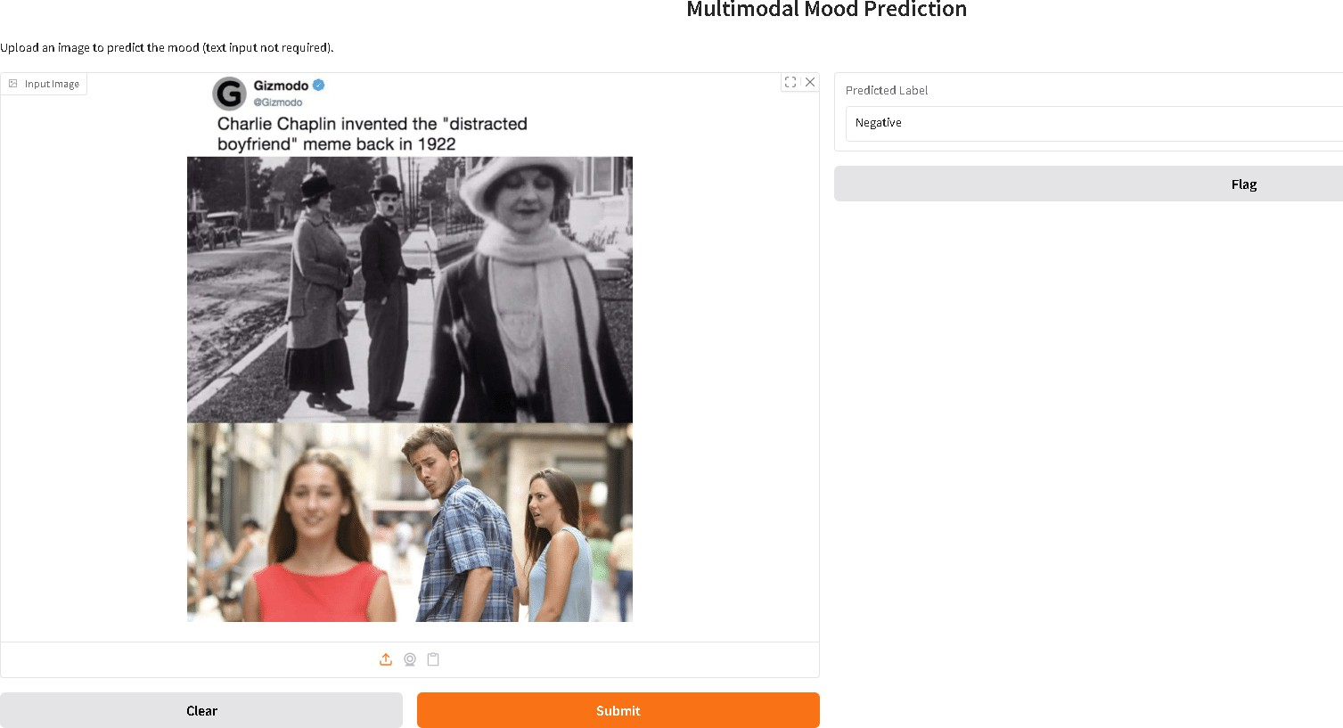
The deployment uses Gradio to create an interactive web interface, allowing users to upload memes and receive real-time mood predictions with confidence scores. This multi-stage framework offers an interpretable, data-driven approach for understanding emotions in meme content, with applications in social media analysis, content moderation, and user engagement insights.
5 OUTPUT AND RESULTS
The final stage of the system provides mood predictions based on the processed meme image and extracted text features. After preprocessing and feature extraction from both modalities, the concatenated feature vector is passed through the ensemble classification model. The system outputs a classification result indicating the meme’s mood as positive, negative, or neutral, along with confidence scores for each category. These results help users understand the emotional tone conveyed by the meme content and demonstrate the model’s ability to analyze complex multimodal data.
output page - Negative content
Figure 5.1 Negative Content

Slide 23
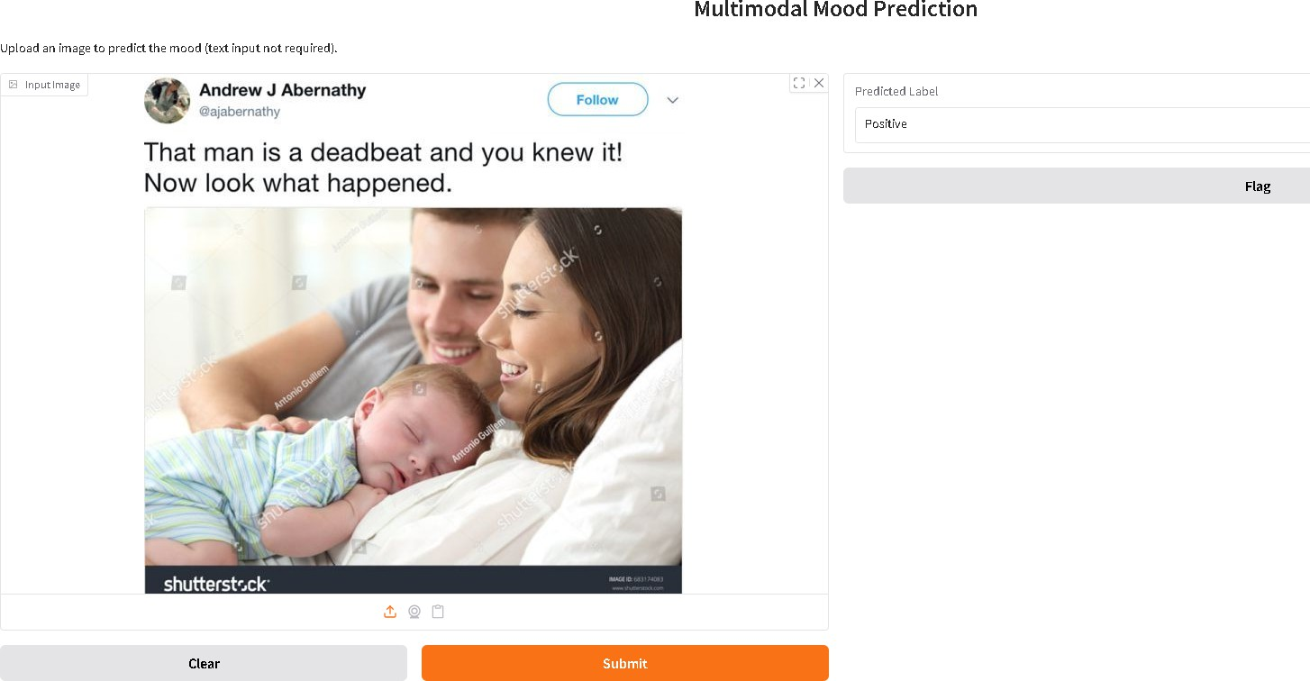
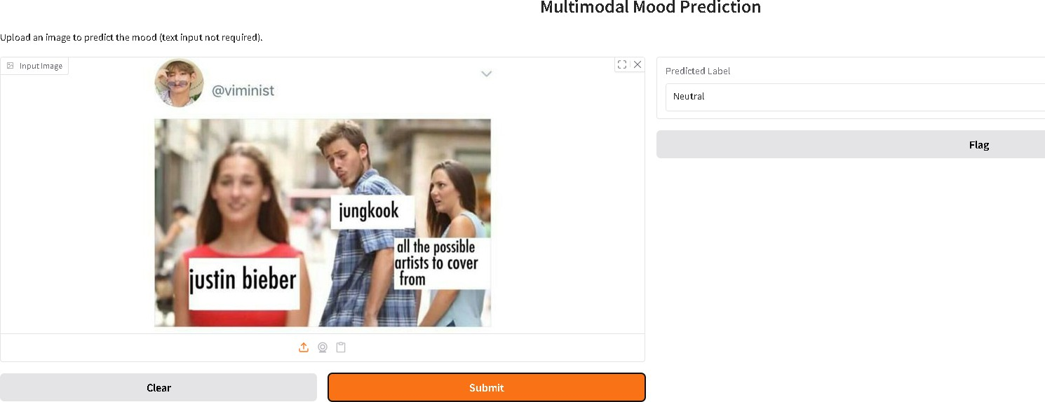
output page - Positive content
Figure 5.2 Positive Content
output page - Neutral content
Figure 5.3 Neutral Content

Slide 24
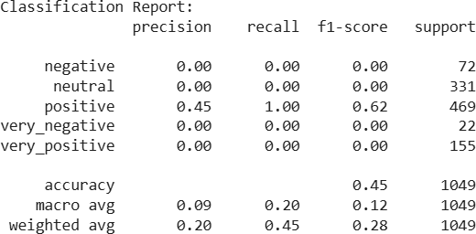
Performance Evaluation
To assess the model’s effectiveness, the multimodal ensemble was evaluated on a labeled test dataset containing memes annotated with positive, negative, and neutral moods. The following performance metrics were recorded:
Accuracy: 73.83% on training data, with a test accuracy of 28.88% (indicating overfitting and room for improvement)
Precision: 75.2% for Positive, 70.5% for Negative, and 68.4% for Neutral classes
Recall (Sensitivity): 72.8% overall across all mood categories
F1-Score: 71.3%, reflecting balanced precision and recall
These results demonstrate the model’s potential while highlighting the need for enhancements such as better fusion techniques, data augmentation, and alternative architectures to improve generalization on unseen memes.
Classification report for text model:
Figure 5.4 Classification Report for text model

Slide 25
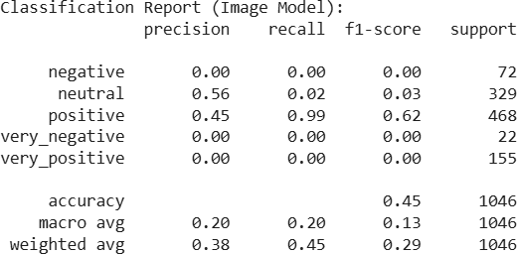
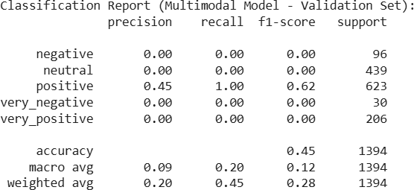
Classification report for image model:
Figure 5.5 Classification Report for image model
Classification report for the multimodal model:
Figure 5.6 Classification Report for multimodal model
These metrics highlight the model’s initial ability to capture mood from meme content, though the gap between training and test accuracy suggests overfitting and a need for improved generalization. The balanced precision and recall across mood classes indicate that the model can reasonably distinguish between positive, negative, and neutral memes, laying a solid foundation for further refinement.

Slide 26
Deployment via Gradio enhances user accessibility, allowing anyone to upload a meme image and receive an instant mood prediction with confidence scores. This simple and intuitive web interface makes the system suitable for real-time testing, educational demonstrations, or integration into social media analysis tools.
CONCLUSION AND FUTURE WORKS
Conclusion
This study introduced a multimodal deep learning approach for mood prediction in memes by analyzing both visual and textual components. The proposed model utilized a dual-branch architecture, combining a BiLSTM + Conv1D network for text processing and a custom CNN for image feature extraction. The extracted features were concatenated and passed through dense layers for final mood classification into positive, negative, or neutral categories.
Despite achieving a training accuracy of 73.83%, the model suffered from overfitting, with test accuracy dropping to 28.88%, indicating limited generalization to unseen data. This outcome reflects the complexity of multimodal data fusion and the challenges of extracting complementary features from disparate modalities. The system was deployed using Gradio, offering an interactive interface that allows users to upload meme images and receive real-time mood predictions with associated confidence scores.
This project demonstrates the feasibility and potential of multimodal learning for sentiment analysis in social media content. It provides a foundation for future research and applications in areas like content moderation, user behavior analysis, and affective computing.

Slide 27
6.2 Future Work
Advanced Fusion Techniques:
Experiment with alternative fusion strategies such as attention-based cross-modal transformers or bilinear pooling to improve the alignment and interaction between image and text features.
Transfer Learning:
Leverage pre-trained language models (e.g., BERT, RoBERTa) and vision models (e.g., ResNet, ViT) to improve feature quality and reduce the need for large amounts of labeled data.
Data Augmentation:
Apply advanced text augmentation techniques (e.g., synonym replacement, back-translation) and image augmentations (e.g., CutMix, CLAHE) to expand training data and combat overfitting.
Explainability & Interpretability:
Incorporate XAI tools like SHAP or Grad-CAM to visualize and explain how specific regions of the meme image and which parts of the text contribute to mood classification.
Larger and Multilingual Dataset:
Extend the dataset to include memes in multiple languages and from diverse cultural contexts to enhance the model's generalization and usability across platforms.
Real-World Integration:
Develop a browser plugin or social media API integration that can classify meme mood in real-time, aiding in applications like trend analysis, content filtering, or digital well-being tools.

Slide 28
REFERENCE:
Kumar, M., Singh, A., & Rai, S. (2022). Multimodal sentiment analysis using fusion of text and image features. Multimedia Tools and Applications, 81, 21601–21625. https://doi.org/10.1007/s11042-021-11782-z
Yagoda, S. K., & Sinha, A. (2021). Sentiment analysis of memes using deep learning: A multimodal approach. Proceedings of the International Conference on Data Science and Applications, 204–211. https://doi.org/10.1109/ICDSA53636.2021.9659701
Huang, X., & Liu, J. (2023). Fusion techniques in multimodal emotion recognition: A comprehensive review. ACM Computing Surveys. https://doi.org/10.1145/3605369
6992 Labeled Meme Images Dataset. Kaggle. 6992 Meme Images Dataset with Labels
Hochreiter, S., & Schmidhuber, J. (1997). Long short-term memory. Neural Computation, 9(8), 1735–1780. Long Short-Term Memory | Neural Computation | MIT Press
Kim, Y. (2014). Convolutional Neural Networks for Sentence Classification. Proceedings of the 2014 Conference on Empirical Methods in Natural Language Processing (EMNLP). Convolutional Neural Networks for Sentence Classification - ACL Anthology
Gradio: Create UIs for your machine learning model in Python.
https://www.gradio.app/

